Slide 1
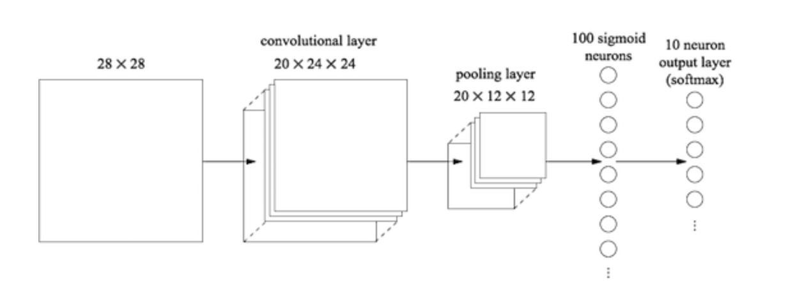
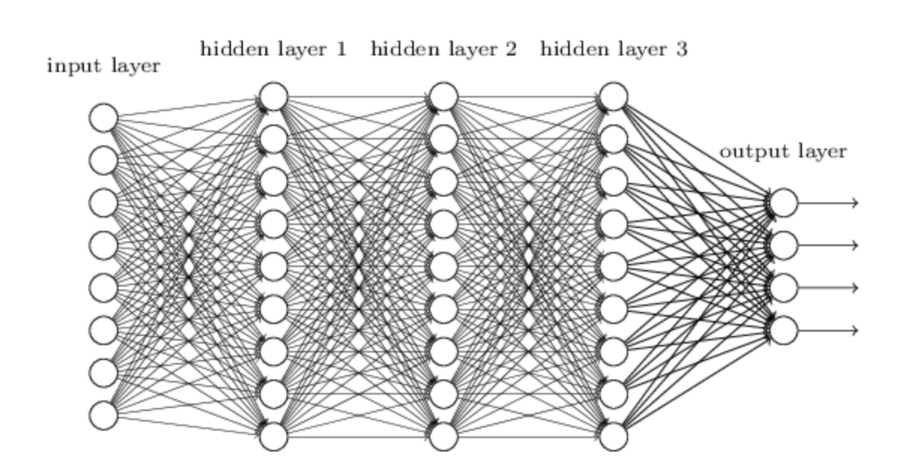

Multilayer neural networks

Slide 2
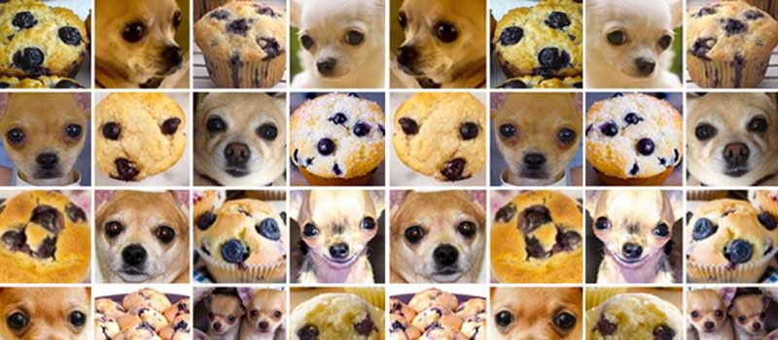
Introduction to multilayer neural networks
Introduce you to the basics multilayer neural networks (MLNNs) aka “deep learning”
Cover basic terminology
Highlight some limitations of MLNNs
Construct some basic neural networks for image analysis
#ChihuahuaOrMuffin

Slide 3
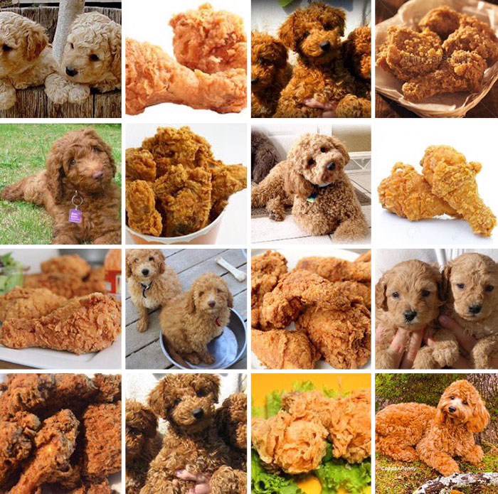
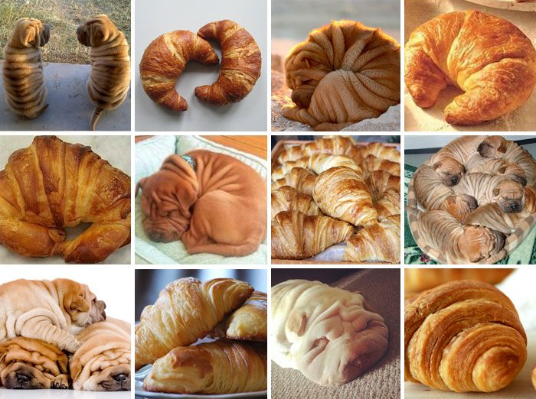
Introduction to multilayer neural networks
#LabradoodleOrFriedChicken
#SharPeiOrCroissant

Slide 4

https://towardsdatascience.com/

Slide 5
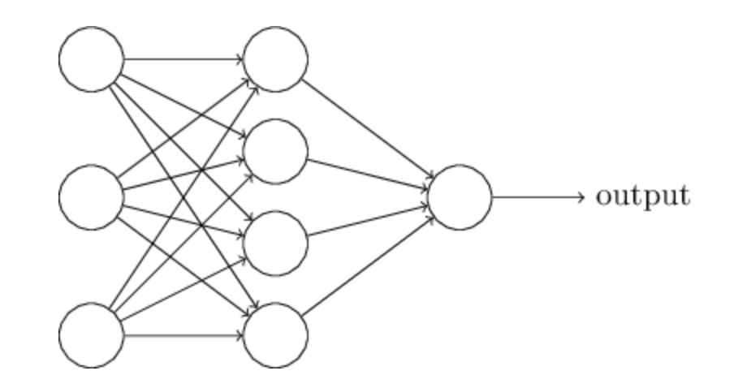
Neural networks
(Nielsen, Neural networks and deep learning)
Neural network: Input nodes → one hidden layer nodes → output nodes

Slide 6
Neural networks

Slide 7
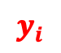



Neural networks
$$w_{1}$$
$$w_{2}$$
$$y_{i}$$
$$w_{3}$$
$$y_{i}=w_{1}x_{1}+w_{2}x_{2}+w_{3}x_{3}+bias$$

Slide 8
Neural networks
$$w_{1}$$
$$w_{2}$$
$$y_{i}$$
$$w_{3}$$
$$y_{i}=w_{1}x_{1}+w_{2}x_{2}+w_{3}x_{3}+bias$$
$$y_{i}=f(w_{1}x_{1}+w_{2}x_{2}+w_{3}x_{3}+bias)$$

Slide 9
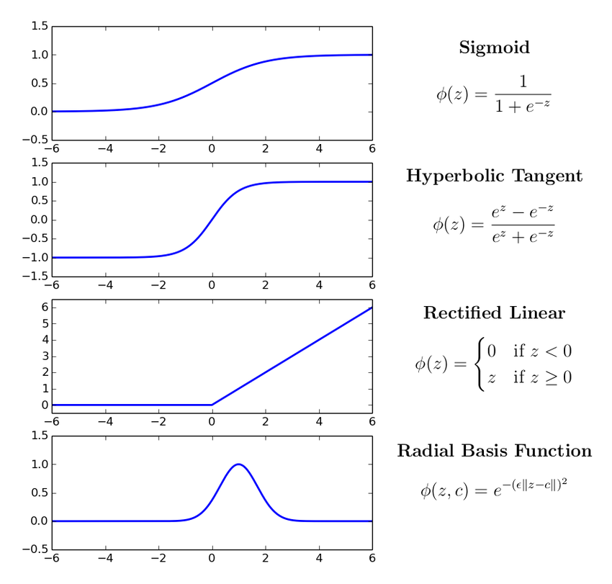
Neural networks
$$w_{1}$$
$$w_{2}$$
$$y_{i}$$
$$w_{3}$$
$$y_{i}=w_{1}x_{1}+w_{2}x_{2}+w_{3}x_{3}+bias$$
$$y_{i}=f(w_{1}x_{1}+w_{2}x_{2}+w_{3}x_{3}+bias)$$

Slide 10
Neural networks
CODE (KerasR)
mod <- Sequential()
mod$add(Dense(4,
input_shape = c(1,3)))
mod$add(Activation("relu"))
mod$add(Dense(1))
Activation("sigmoid")
Neural network: Input nodes → one hidden layer nodes → output nodes
Activation("linear")

Slide 11
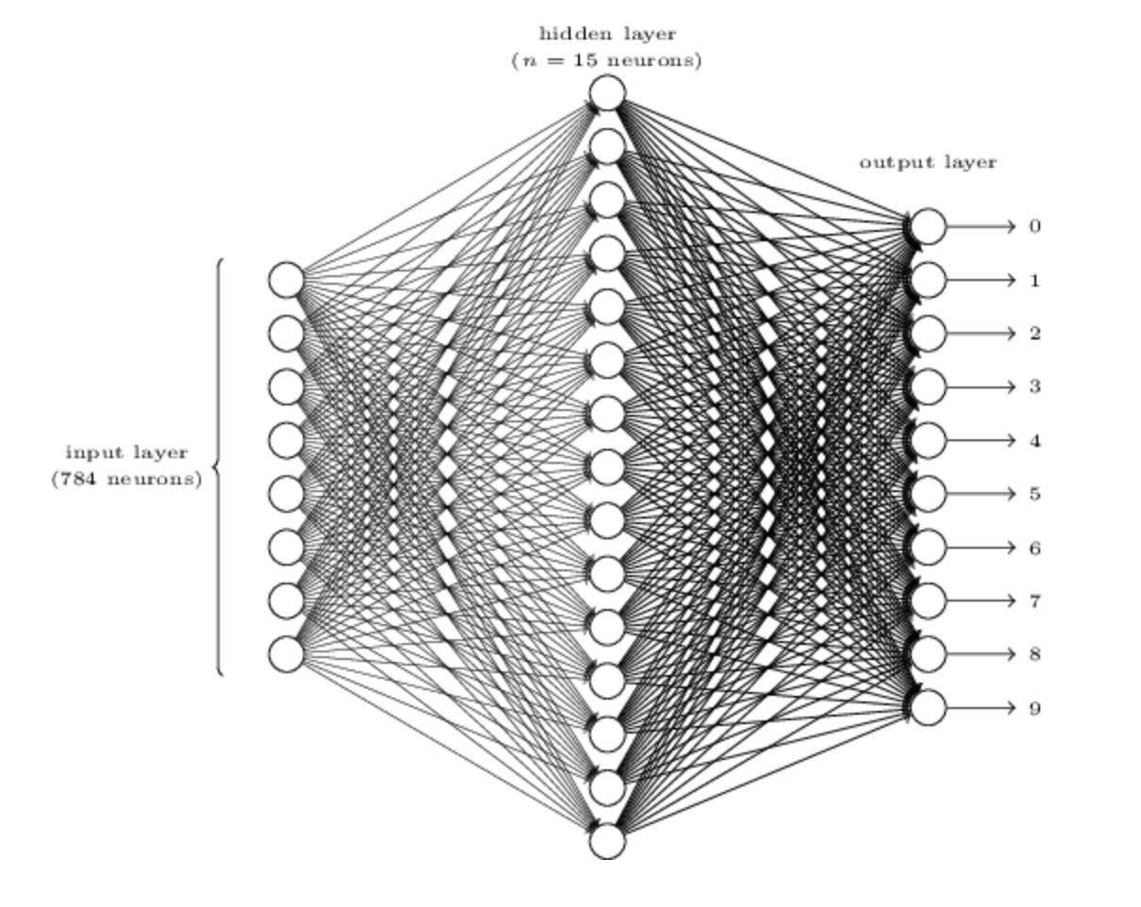
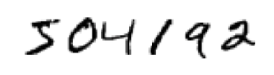
28x28 pixels
(Nielsen, Neural networks and deep learning)
Slightly more realistic neural network: digit classification (0 – 9)

Slide 12
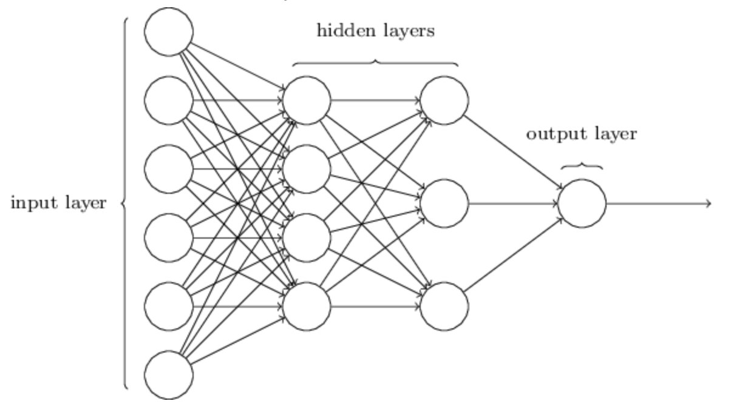
Multilayer Neural networks
(Nielsen, Neural networks and deep learning)

Slide 13
Multilayer Neural networks
(Nielsen, Neural networks and deep learning)

Slide 14
Multilayer Neural networks
CODE
mod <- Sequential()
mod$add(Dense(9,
input_shape = c(1,8)))
mod$add(Activation("relu"))
mod$add(Dense(9))
mod$add(Activation("relu"))
mod$add(Dense(9))
mod$add(Activation("relu"))
mod$add(Dense(4))
mod$add(Activation("sigmoid"))

Slide 15
Multilayer Neural networks
CODE
mod <- Sequential()
mod$add(Dense(9,
input_shape = c(1,8)))
mod$add(Activation("relu"))
mod$add(Dense(9))
mod$add(Activation("relu"))
mod$add(Dense(9))
mod$add(Activation("relu"))
mod$add(Dense(4))
mod$add(Activation("sigmoid"))
keras_compile(mod, loss = ‘categorical_crossentropy', metrics = c(‘categorical_accuracy'), optimizer = RMSprop())
keras_fit(mod, trainX, trainY, validation_data = list(valX, valY), batch_size = 32, epochs = 25, verbose = 1)

Slide 16
Multilayer Neural networks
 | Activation | Loss | Metrics
Binary | sigmoid | binary_crossentropy | binary_accuracy
Multiclass/multilabel | sigmoid | binary_crossentropy | binary_accuracy
Categorical | softmax | categorical_crossentropy | categorical_accuracy
Continuous | linear | mean_squared_error | mean_squared_error

Slide 17

Multilayer Neural networks
Lots of parameters
Accurate MLNNs use a lot of data. I mean A LOT!
Data augmentation
Difficult to do all at once
Use stochastic gradient descent (process smaller sets of data at a time)
Minibatch size: number of input samples to used in stochastic gradient descent (optimiser)
Epoch: one full sweep through all minibatches
Standard neural networks not ideal for image analysis
PARAMETERS

Slide 18
Convolutional neural networks
(Nielsen, Neural networks and deep learning)

Slide 19
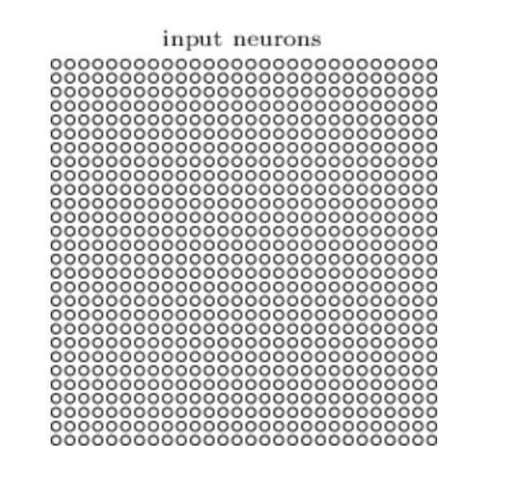
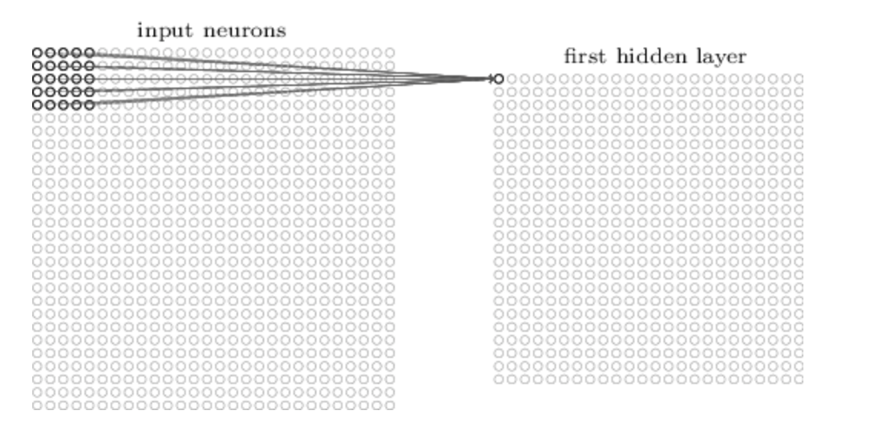
Convolutional neural networks
(Nielsen, Neural networks and deep learning)
Image (set of pixels)
Convolution layer
Scans across the image using a filter to create a feature map

Slide 20
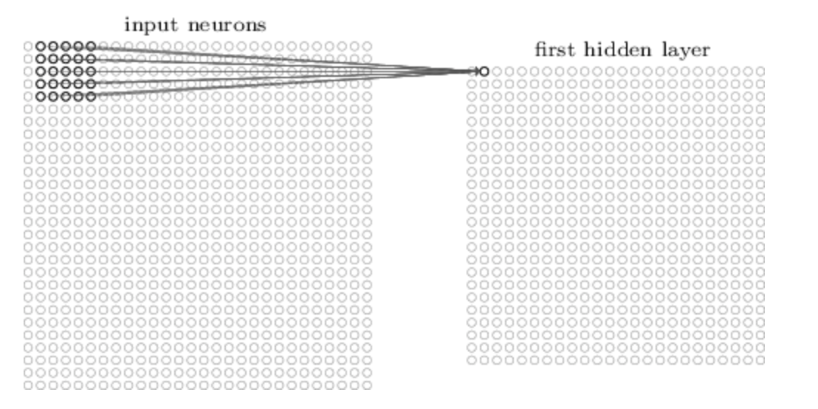
Convolutional neural networks
Image (set of pixels)
Convolution layer
Scans across the image using a filter to create a feature map

Slide 21
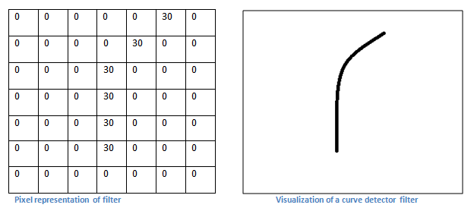
Convolutional neural networks
https://adeshpande3.github.io/A-Beginner%27s-Guide-To-Understanding-Convolutional-Neural-Networks/

Slide 22
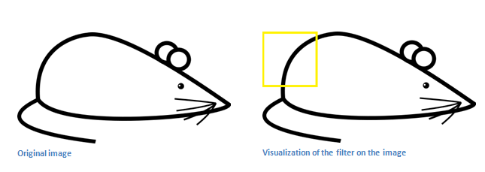
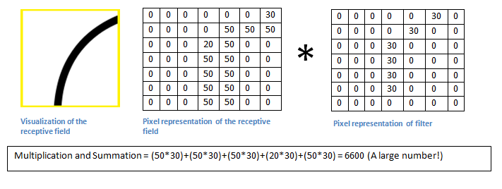
Convolutional neural networks
https://adeshpande3.github.io/A-Beginner%27s-Guide-To-Understanding-Convolutional-Neural-Networks/

Slide 23
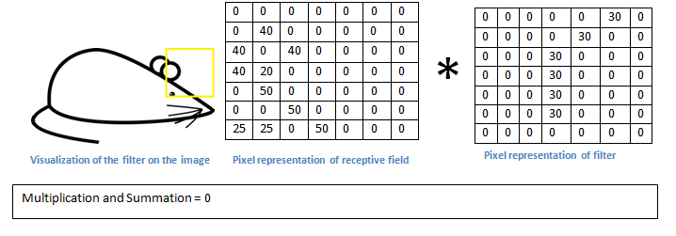
Convolutional neurual networks
https://adeshpande3.github.io/A-Beginner%27s-Guide-To-Understanding-Convolutional-Neural-Networks/

Slide 24
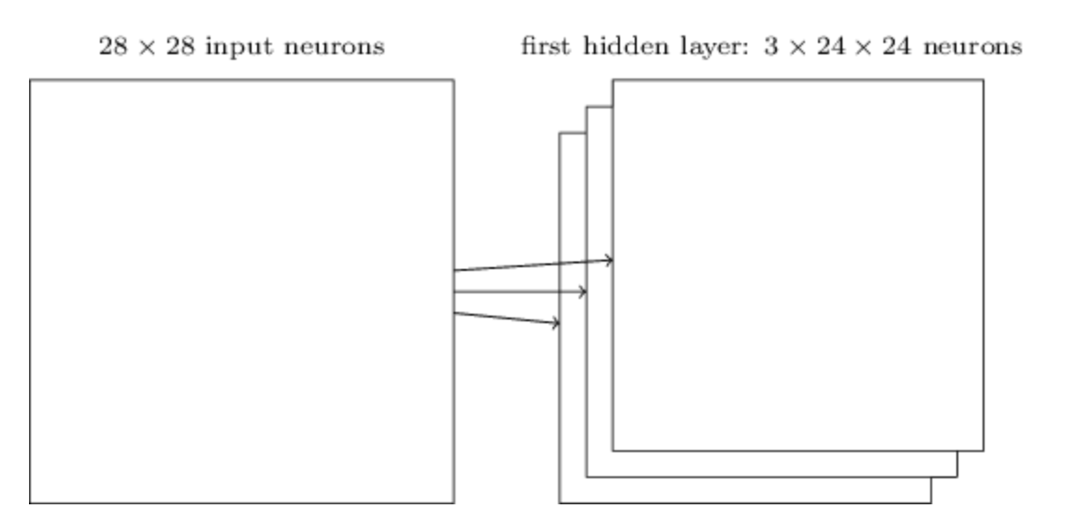
Convolutional neurual networks
Usually want to learn more than one feature map
CODE
mod$add(Conv2D(filters = 3, kernel_size = c(4, 4),input_shape = c(28,28,3)))

Slide 25
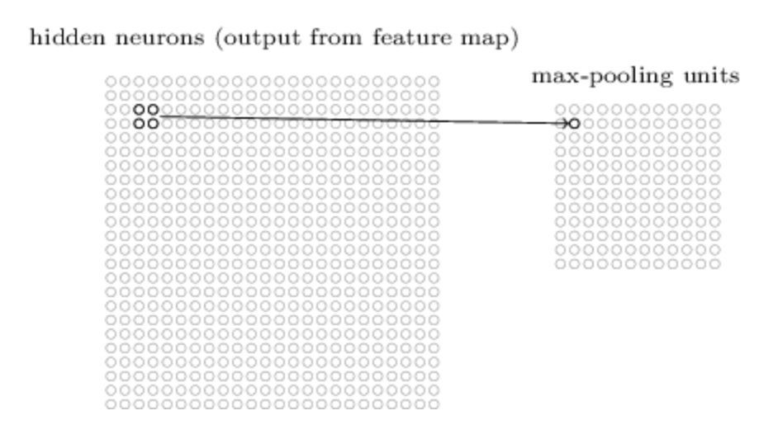
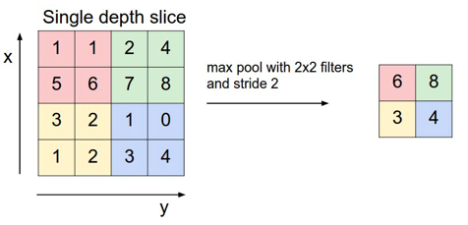
Pooling layers
CODE
mod$add(MaxPooling2D(pool_size=c(2, 2)))

Slide 26
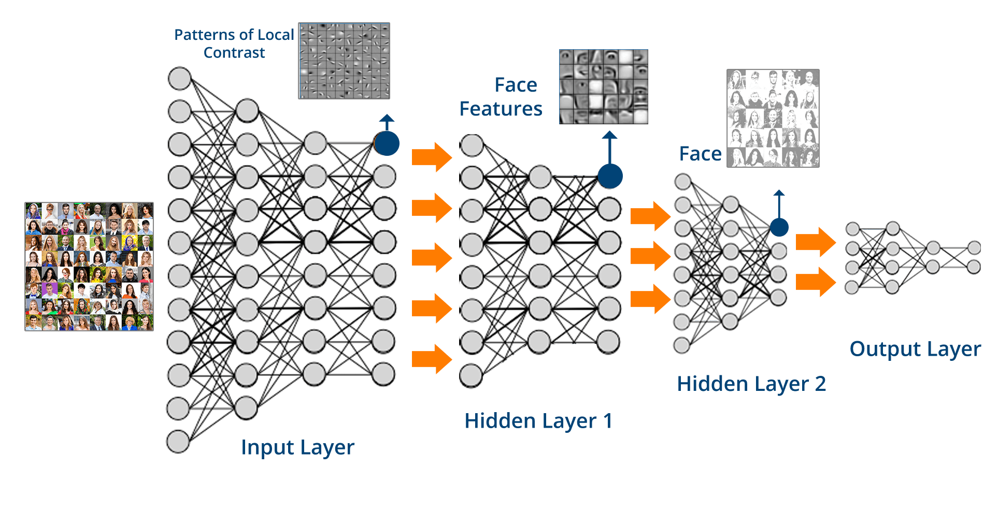
Convolutional neural networks
Human?
Fab hair?

Slide 27
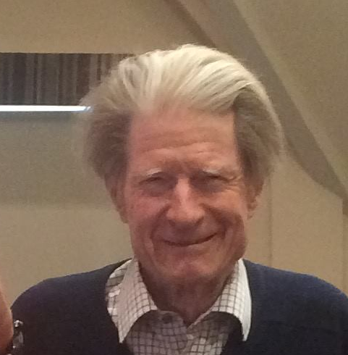
Convolutional neural networks
Human?
Fab hair?

Slide 28
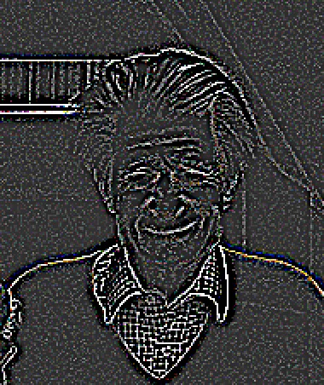
Convolutional neural networks
Human?
Fab hair?

Slide 29
Convolutional neural networks
Human?
Fab hair?

Slide 30
Convolutional neural networks
Human?
Fab hair?

Slide 31
Convolutional neural networks
Human?
Fab hair?

Slide 32
Convolutional neural networks
Human?
Fab hair?

Slide 33
Applications?

Slide 34
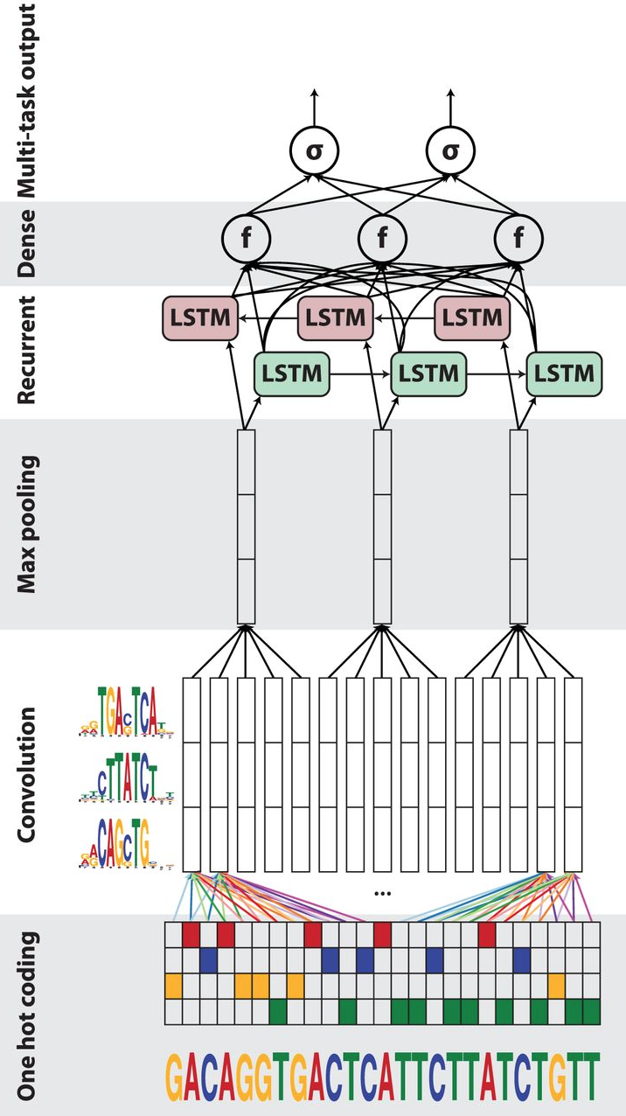
Applications?
Things with proximity based effects (spatial, temporal)
Predict motifs associated with peaks in a ChIP dataset
Associate histone modifications associated with gene behavior
DanQ

Slide 35
CODE
mod$add(Conv2Dtranspose(filters = 3, kernel_size = c(4, 4))
mod$add(UpSampling2D(size=c(2,2)))

Slide 36
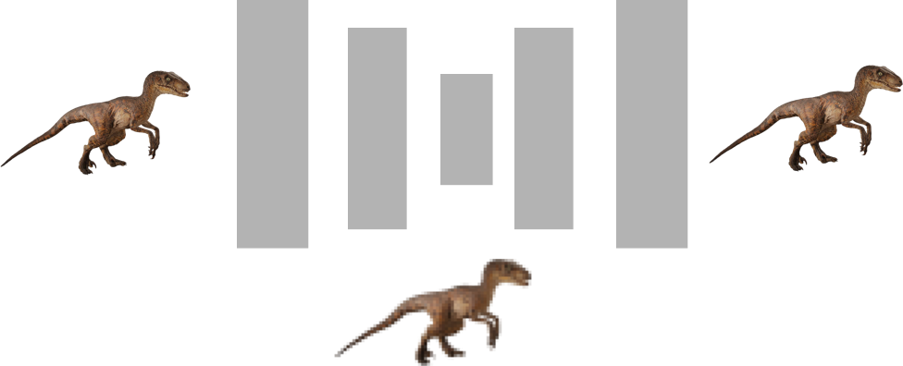
Autoencoders
Input
Output
Compressed representation

Slide 37
Autoencoders - denoising
Noisy input
Clean output

Slide 38
Autoencoders - upscaling
Low res. input
High res. output

Slide 39
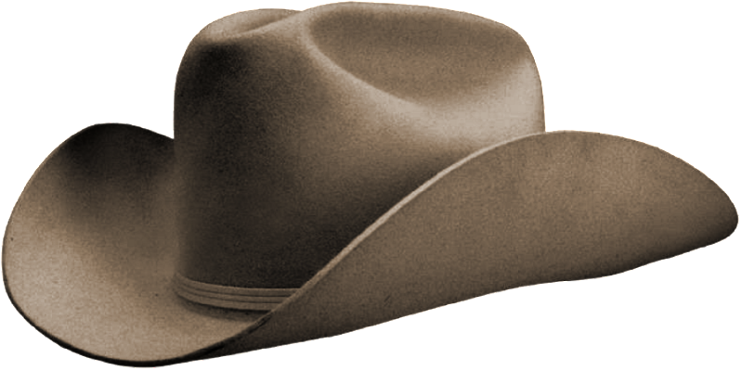
Autoencoders - transformations
Low res. input
High res. output

Slide 40
Example of upsampling a video

Slide 41

Generative Adversarial Networks
CNN
Image credit: Thalles Silva

Slide 42
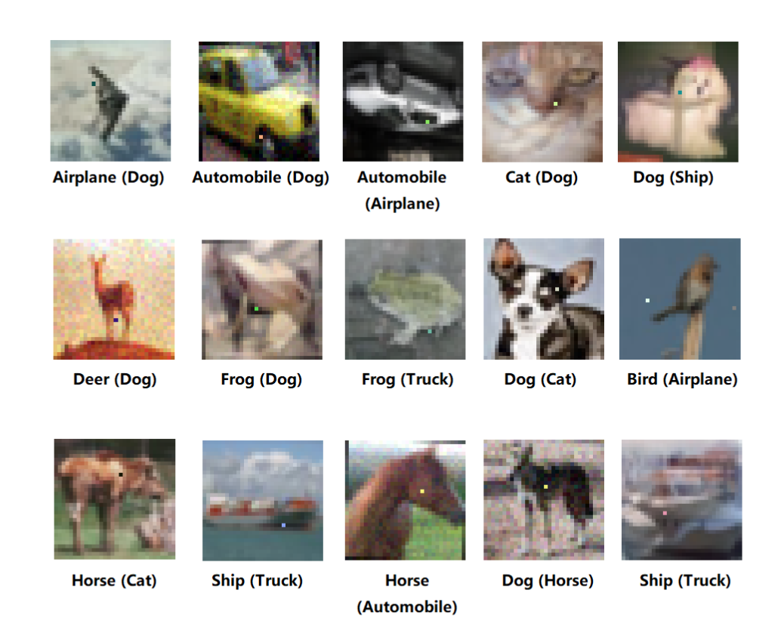
Still early days
Architecture still an area of active research:
(Conv → Pool)_{N} → Dense
When in doubt don’t be a hero look at the best performing architectures (transfer learning)
Some of the best image classifiers use millions of images
Do you have millions of data points?
Can do a reasonable job with 10k images
Rule of thumb: at least 1000 images per class
Augment your data!
https://arxiv.org/abs/1710.08864

Slide 43
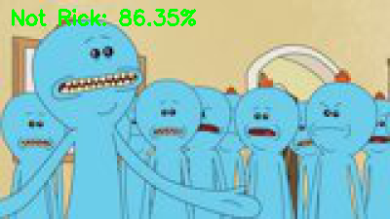

Task
Implement a convolutional neural network that can recognise images of Rick Sanchez vs not Rick from the TV series Rick & Morty
https://masterofallscience.com
When you have the network up and running, feel free to modify the architecture
https://github.com/cap76/RickVision

Slide 44
DeepExplain

